Slide 1
Data Development Utilizing Database Design and SQL
Day 4
Notes:
1

Slide 2
Constructing Simple Queries
What is a query ?
Question represented in a way that the DBMS can understand
How do you implement in SQL?
Use SELECT command
Are there any special formatting rules?
No

Slide 3
Constructing Simple Queries
SELECT-FROM-WHERE statement
SELECT columns to include in result
FROM table containing columns
WHERE any conditions to apply to the data
The WHERE clause is optional

Slide 4
Retrieving Certain Columns and Rows
Use SELECT command to retrieve specified columns and all rows
List the number, name, and balance of all customers
No WHERE clause needed, because all customers are requested

Slide 5
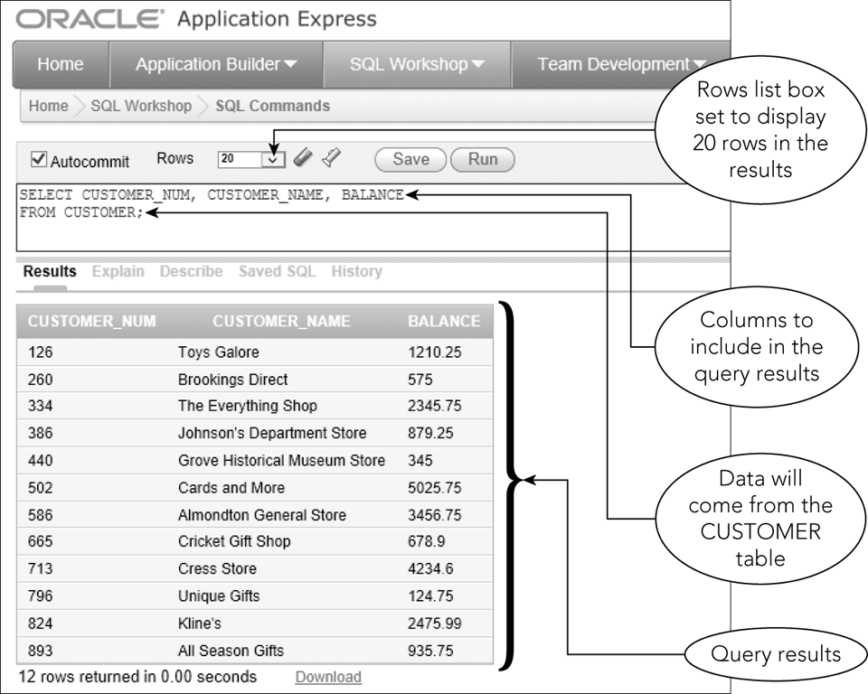
Retrieving Certain Columns and Rows
Figure 4-1: SELECT command to select certain columns from the CUSTOMER table

Slide 6
Retrieving All Columns and Rows
Use an asterisk (*) to indicate all columns in the SELECT clause
Will list all columns in the order used when table was created
List specific columns in SELECT clause to present columns in a different order

Slide 7
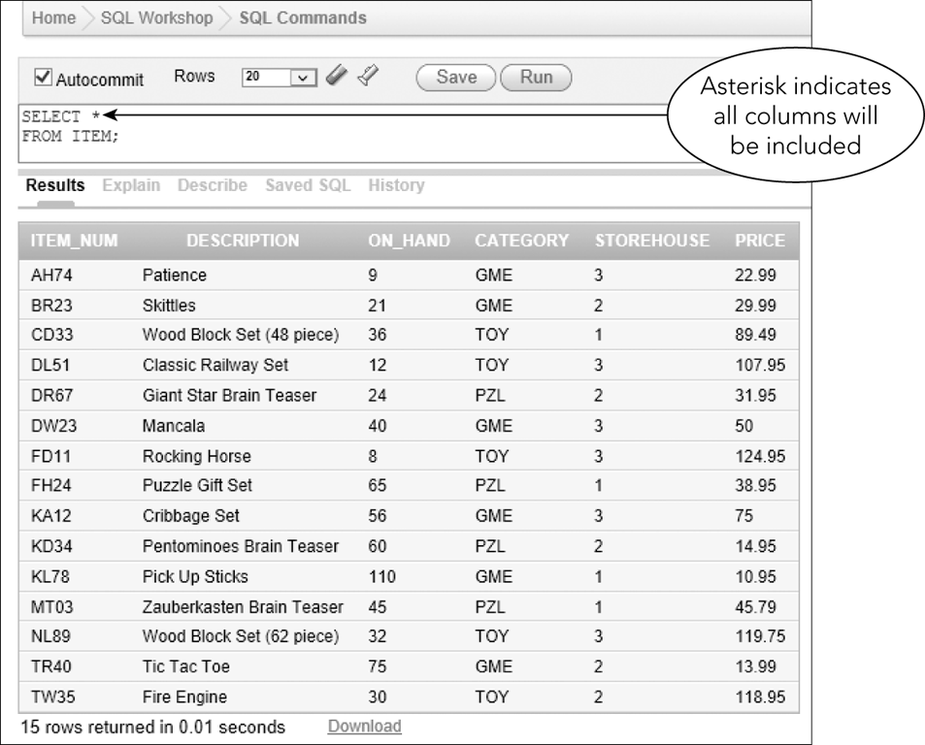
Retrieving All Columns and Rows
Figure 4-2: SELECT command to select all columns from the ITEM table

Slide 8
Using a WHERE Clause
WHERE clause
Used to retrieve rows that satisfy some condition
What is the name of customer number 126?
Simple Condition
Column name, comparison operator followed by either a column name or a value

Slide 9
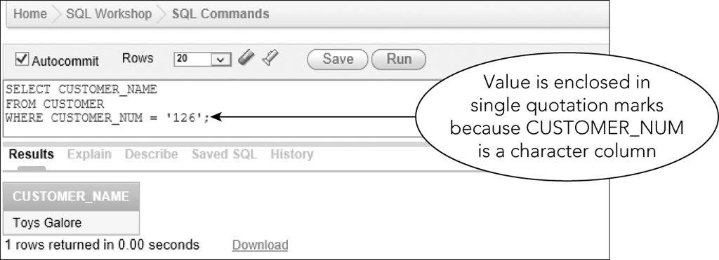
Using a WHERE Clause
Figure 4-3: SELECT command to find the name of customer number 126

Slide 10
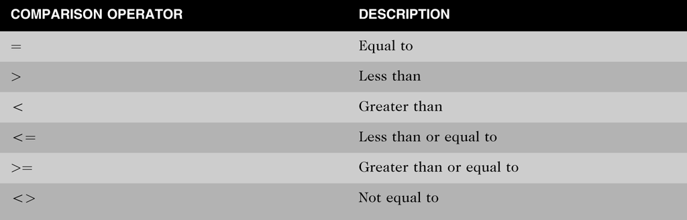
Using a WHERE Clause
Figure 4-4: Comparison operators used in SQL commands

Slide 11
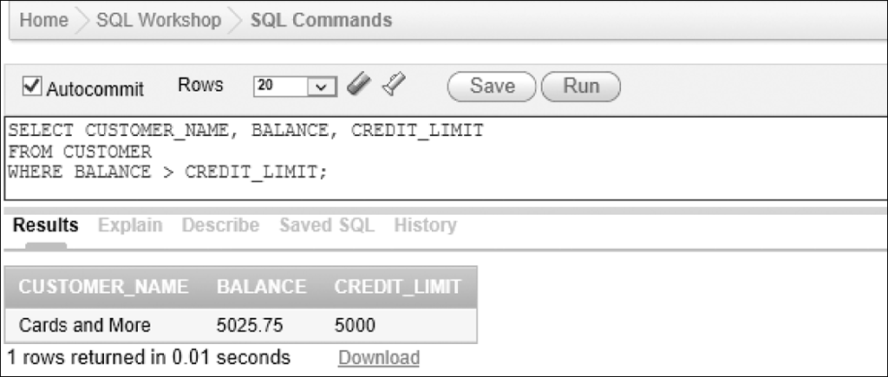
Using a WHERE Clause
Simple conditions can compare columns
Figure 4-6: SELECT command to find all customers with balances that exceed their credit limits

Slide 12
Using Compound Conditions
Compound conditions
Connect two or more simple conditions with AND, OR, and NOT operators
AND operator: all simple conditions are true
OR operator: any simple condition is true
NOT operator: reverses the truth of the original condition

Slide 13
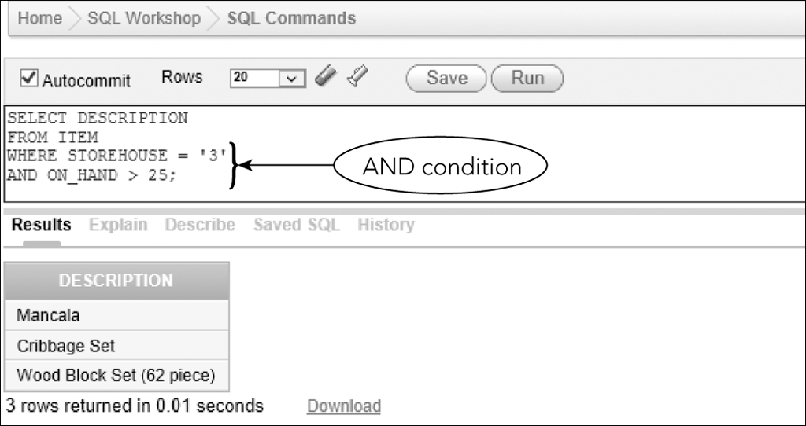
Using Compound Conditions
Figure 4-7: SELECT command with an AND condition on separate lines

Slide 14
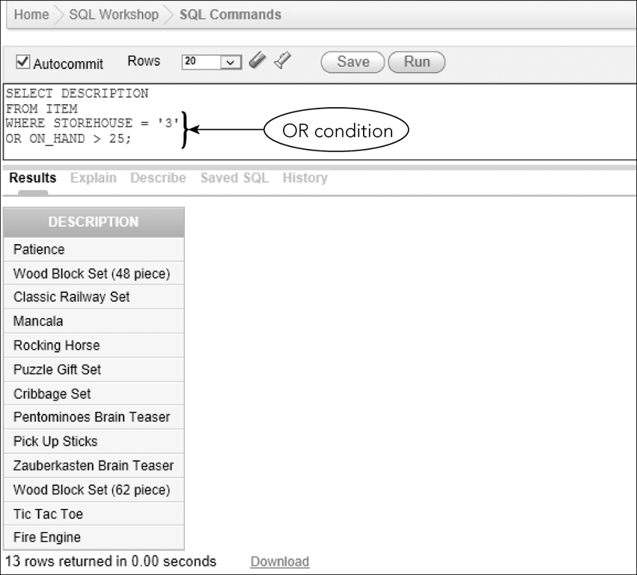
Using Compound Conditions
Figure 4-9: SELECT command with an OR condition

Slide 15
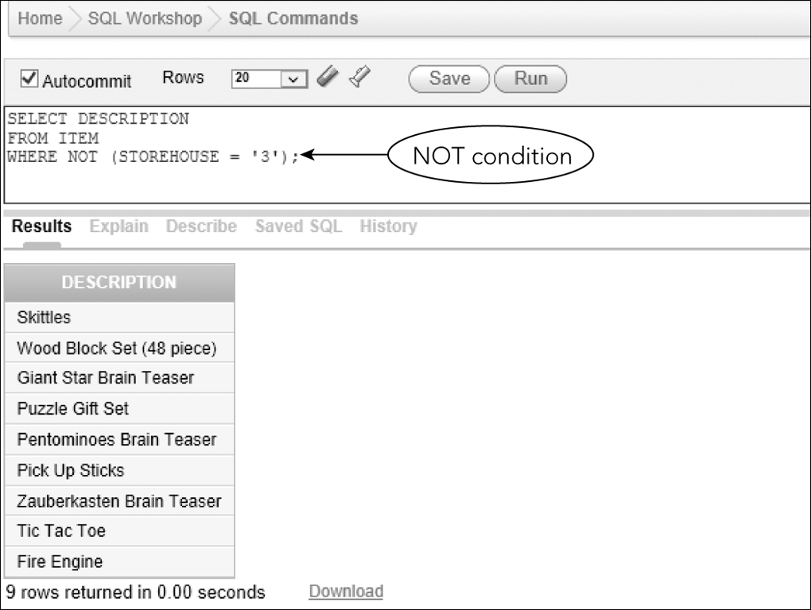
Using Compound Conditions
Figure 4-10: SELECT command with a NOT condition

Slide 16
Using the BETWEEN Operator
Use instead of AND operator
Use when searching a range of values
Makes SELECT commands simpler to construct
Inclusive
When using BETWEEN 2000 and 5000, values of 2000 or 5000 would be true

Slide 17
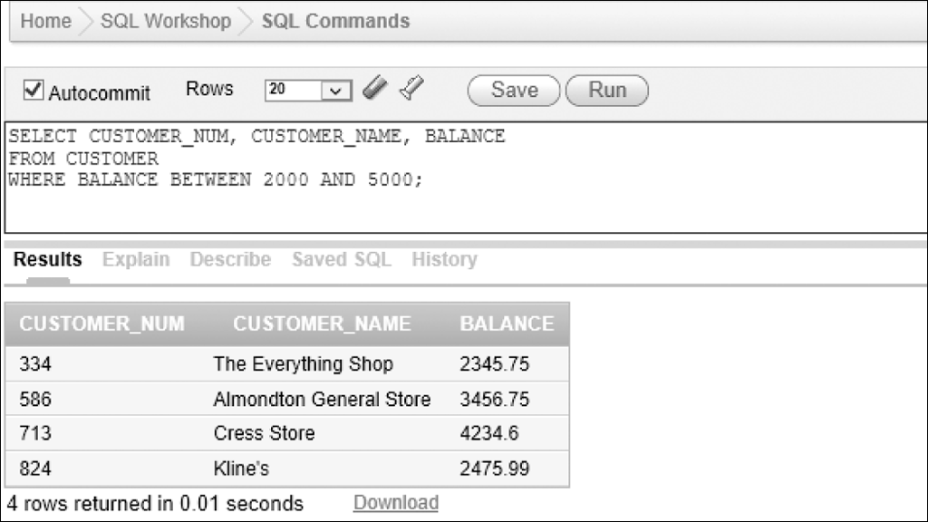
Using the BETWEEN Operator
Figure 4-12: SELECT command with the BETWEEN operator

Slide 18
Using Computed Columns
Computed column
Does not exist in the database but is computed using data in existing columns
Arithmetic operators
+ for addition
- for subtraction
* for multiplication
/ for division

Slide 19
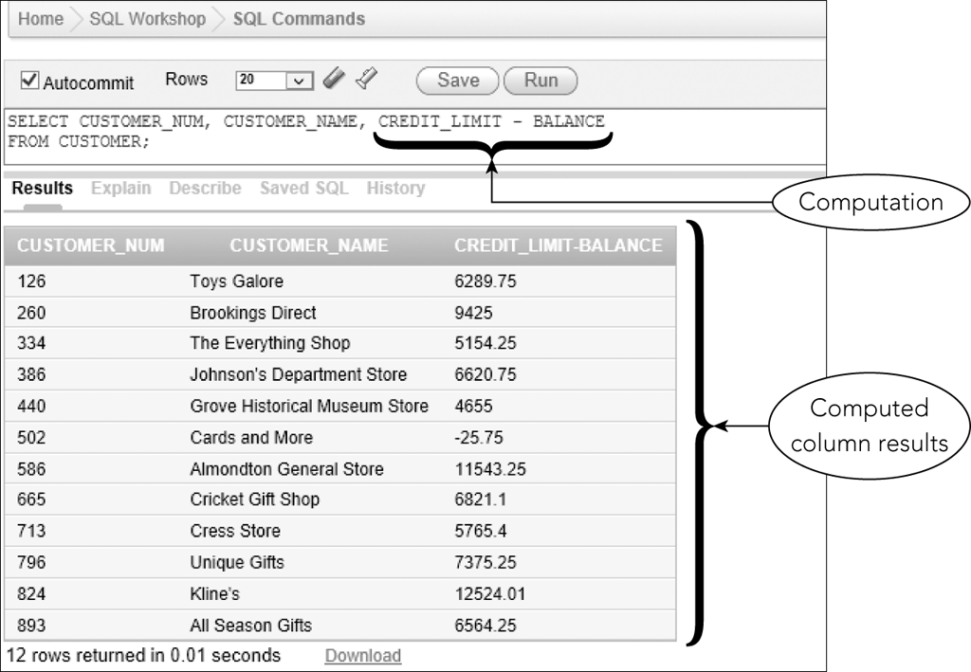
Using Computed Columns
Figure 4-14: SELECT command with a computed column

Slide 20
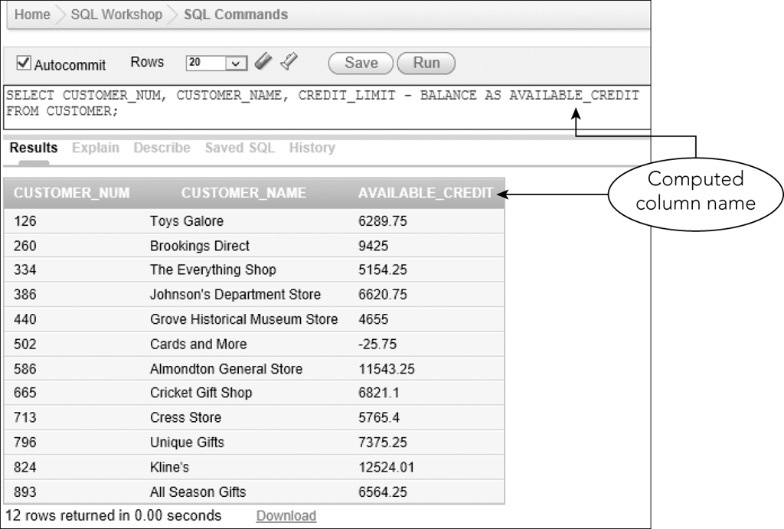
Using Computed Columns
Use AS clause to assign a name
Figure 4-15: SELECT command with a named computed column

Slide 21
Using the LIKE Operator
Used for pattern matching
LIKE %Columbus% will retrieve data with those characters
“123 Columbus” or “Columbusia”
Underscore (_) represents any single character
“T_M” for TIM or TOM or T3M

Slide 22
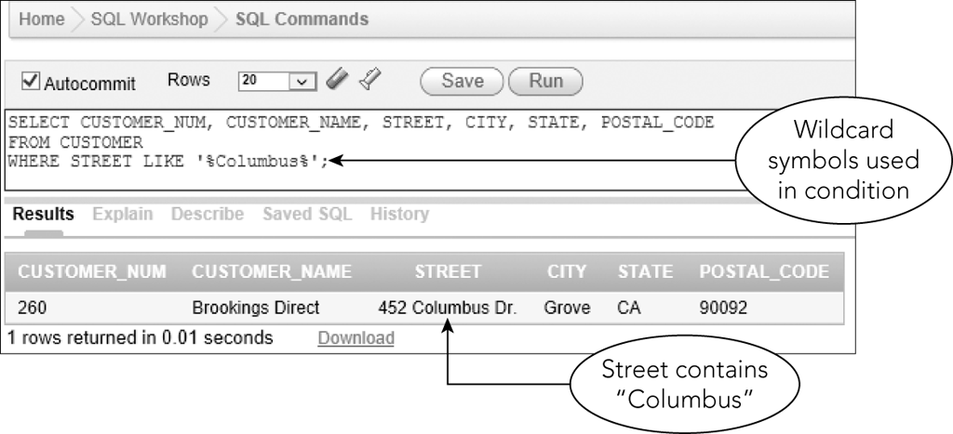
Using the LIKE Operator
Figure 4-17: SELECT command with a LIKE operator and wildcards

Slide 23
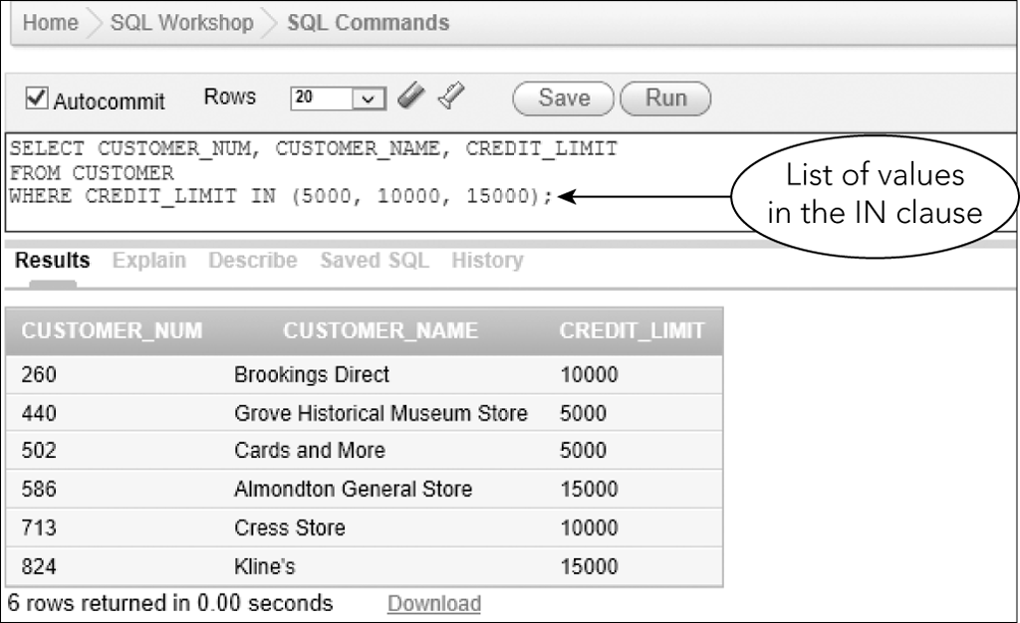
Using the IN Operator
Concise phrasing of OR conditions
Figure 4-19: SELECT command with an IN clause

Slide 24
Sorting
By default, no defined order in which results are displayed
Use ORDER BY clause to list data in a specific order

Slide 25
Using the ORDER BY Clause
Sort key or key
Column on which data is to be sorted
Ascending is default sort order

Slide 26
Additional Sorting Options
Possible to sort data by more than one key
Major sort key and minor sort key
List sort keys in order of importance in the ORDER BY clause
For descending order sort, use DESC
For ascending order sort, use ASC

Slide 27
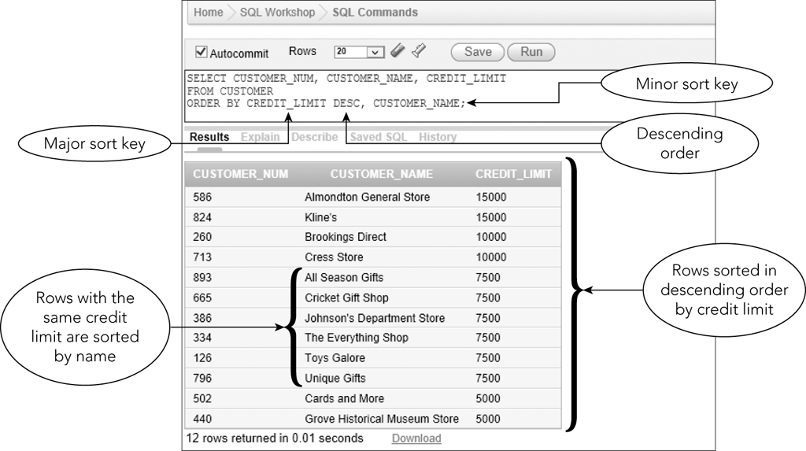
Additional Sorting Options
Figure 4-21: SELECT command to sort data using multiple sort keys

Slide 28
Exercise
Use the TAL Distributors database to complete the following tasks:
List the item number, description and price for all items.
List all rows and columns for the complete ORDERS table.
List the names of customers with credit limits of $10,000 or more.
List the order number for each order placed by customer number 126 (choose another number if necessary)
List the item number and description of each item that is not in category PZL.

Slide 29
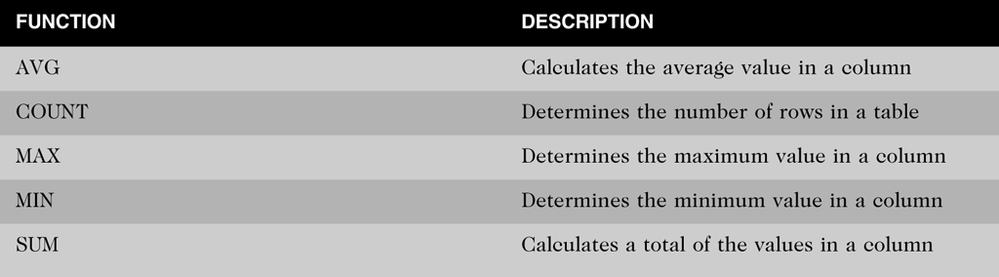
Using Functions
Aggregate functions
Apply to groups of rows
Figure 4-22: SQL aggregate functions

Slide 30
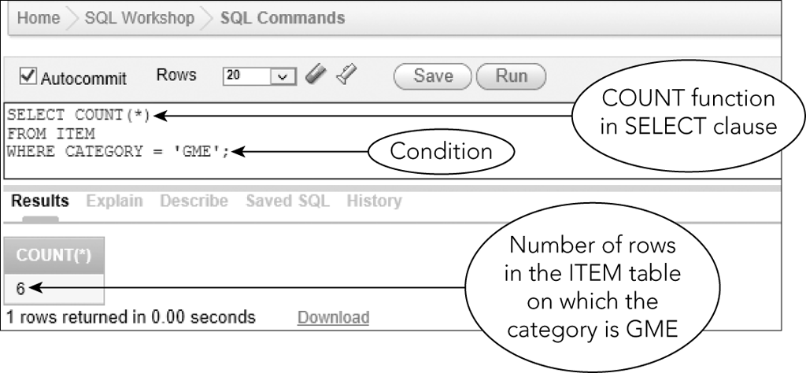
Using the COUNT Function
Counts the number of rows in a table
Can use asterisk (*) to represent any column
Figure 4-23: SELECT command to count rows

Slide 31
Using the SUM Function
Used to calculate totals of columns
Column must be specified and must be numeric
Null values are ignored

Slide 32
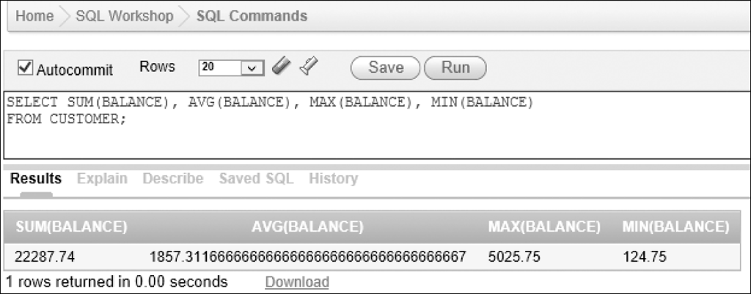
Using the AVG, MAX, and MIN Functions
Numeric columns only
Ignores nulls
Figure 4-25: SELECT command with several functions

Slide 33
Using the DISTINCT Operator
Eliminates duplicate values
Used with COUNT function

Slide 34
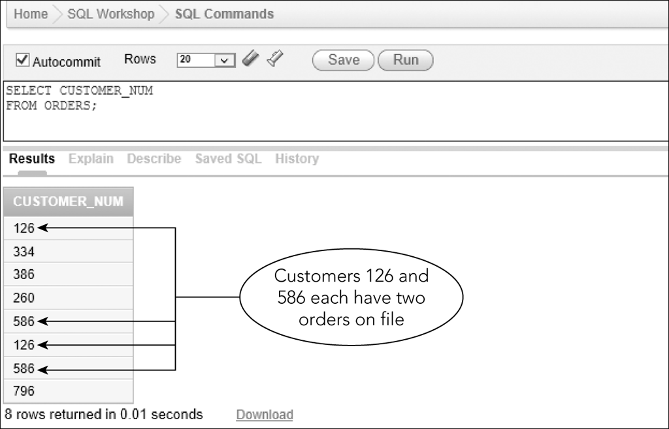
Using the DISTINCT Operator
Figure 4-26: Number of customers with open orders

Slide 35
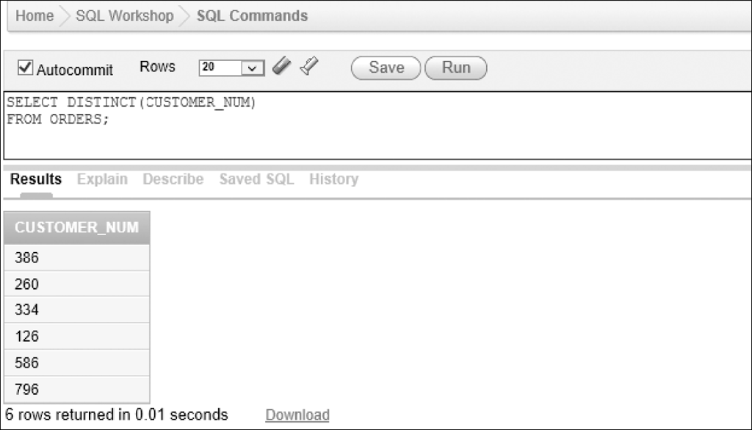
Using the DISTINCT Operator
Figure 4-27: Number of customers with open orders and with duplicates removed

Slide 36
Nesting Queries
Query results require two or more steps
Subquery: an inner query placed inside another query
Outer query uses subquery results

Slide 37
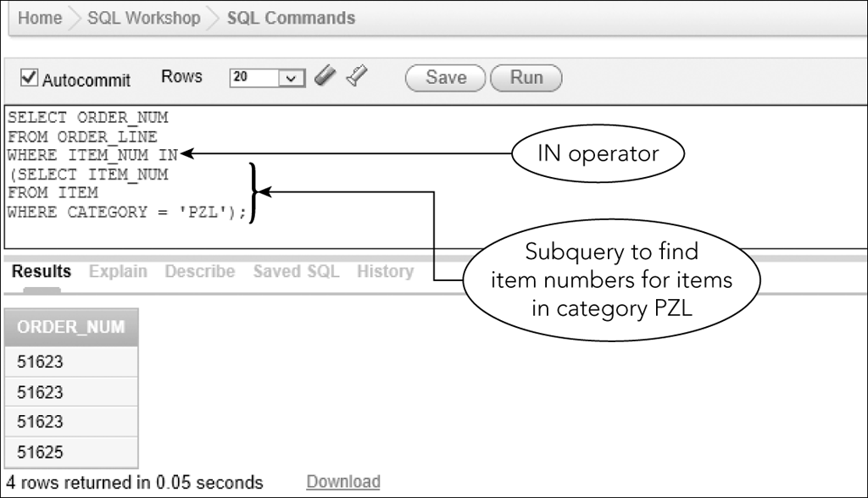
Nesting Queries
Figure 4-32: Using the IN operator and a subquery

Slide 38
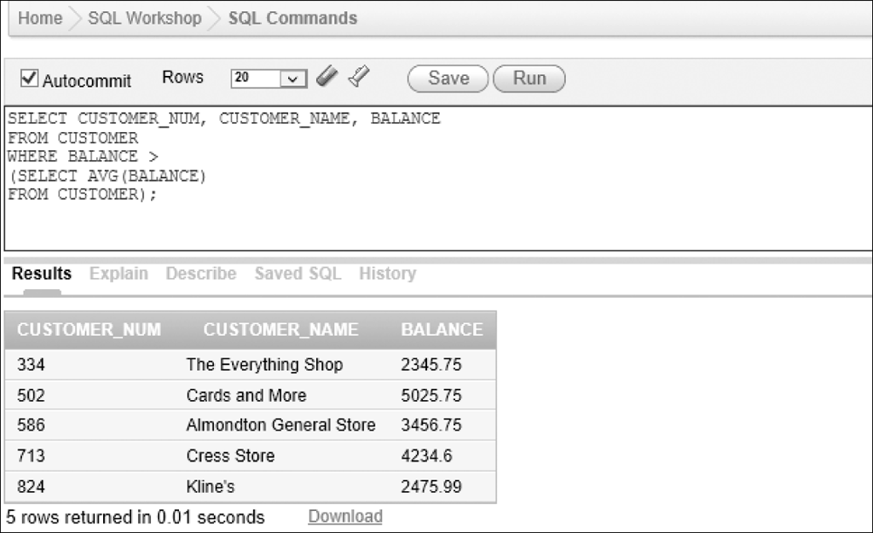
Nesting Queries
Figure 4-33: Query using an operator and a subquery

Slide 39
Grouping
Grouping: creates groups of rows that share common characteristics
Calculations in the SELECT command are performed for the entire group

Slide 40
Using the GROUP BY Clause
Group data on a particular column
Calculate statistics

Slide 41
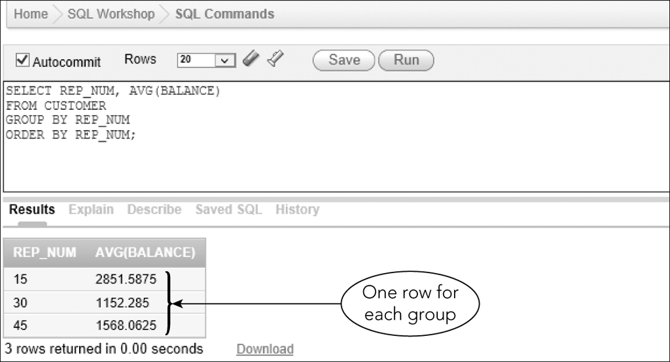
Using the GROUP BY Clause
Figure 4-34: Grouping records on a column

Slide 42
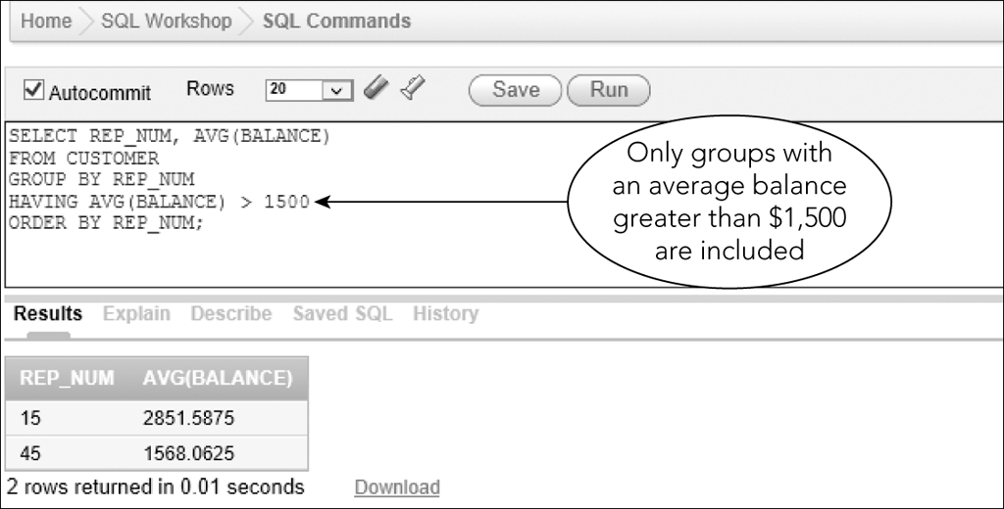
Using a HAVING Clause
Used to restrict groups that will be included
Figure 4-35: Restricting the groups to include in the results

Slide 43
Having vs. Where
WHERE: limit rows
HAVING: limit groups
Can use together if condition involves both rows and groups

Slide 44
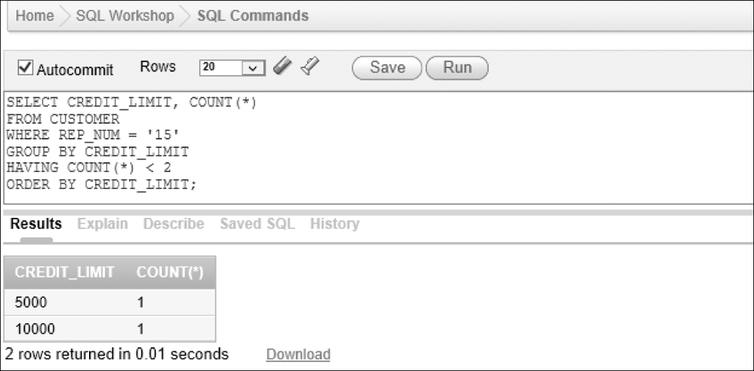
Having vs. Where
Figure 4-39: Restricting the rows and the groups

Slide 45
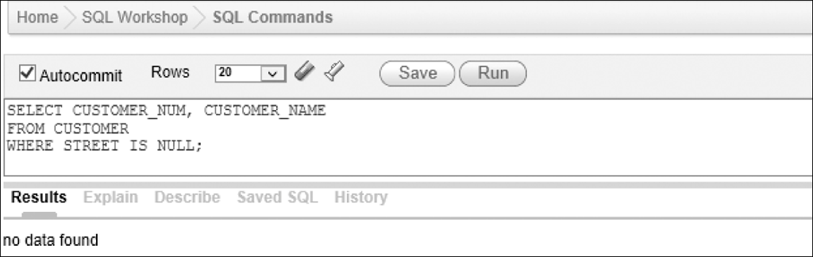
Nulls
Condition that involves a column that can be null
IS NULL
IS NOT NULL
Figure 4-40: Selecting rows containing null values in the STREET column

Slide 46
Summary
Create queries that retrieve data from a single table using SELECT commands
Comparison operators
=, >,=>,<,=<, or <>, or !=
Compound conditions
AND,OR, and NOT
Use the BETWEEN operator
Use the LIKE operator

Slide 47
Summary
IN operator
ORDER BY clause
Aggregate functions
COUNT, SUM, AVG, MAX, and MIN
DISTINCT operator
Subqueries
GROUP BY
HAVING
NULL

Slide 48
Exercise
Create the Colonial Adventure Tours (CAT) database with sample data as shown in Figures 1-4 through 1-8 in the book.
Run the following queries on the CAT DB:
List the last name of each guide that does not live in Massachusetts.
List the trip name of each trip that has the type Biking.
List all Biking trips with distance over 10 miles.
How many trips are there in Maine and Massachusetts?
How many trips originate in each state?
How many reservations include a trip price grater than $20 but less than $75.
How many trips of each type are there?
CAT calculates the total price of a trip by adding the trip price plus other fees and multiplying the result by the number of persons included in the reservation. List the reservation ID, trip ID, customer number and total price for all reservations where the number of persons is greater than four. Use the TOTAL_PRICE column for the calculated field.
What is the average distance and the average maximum group size fore each type of trip?
Display the different seasons when trips are offered. List each season only once.
What is the longest distance for a Biking trip?

